Slide 1



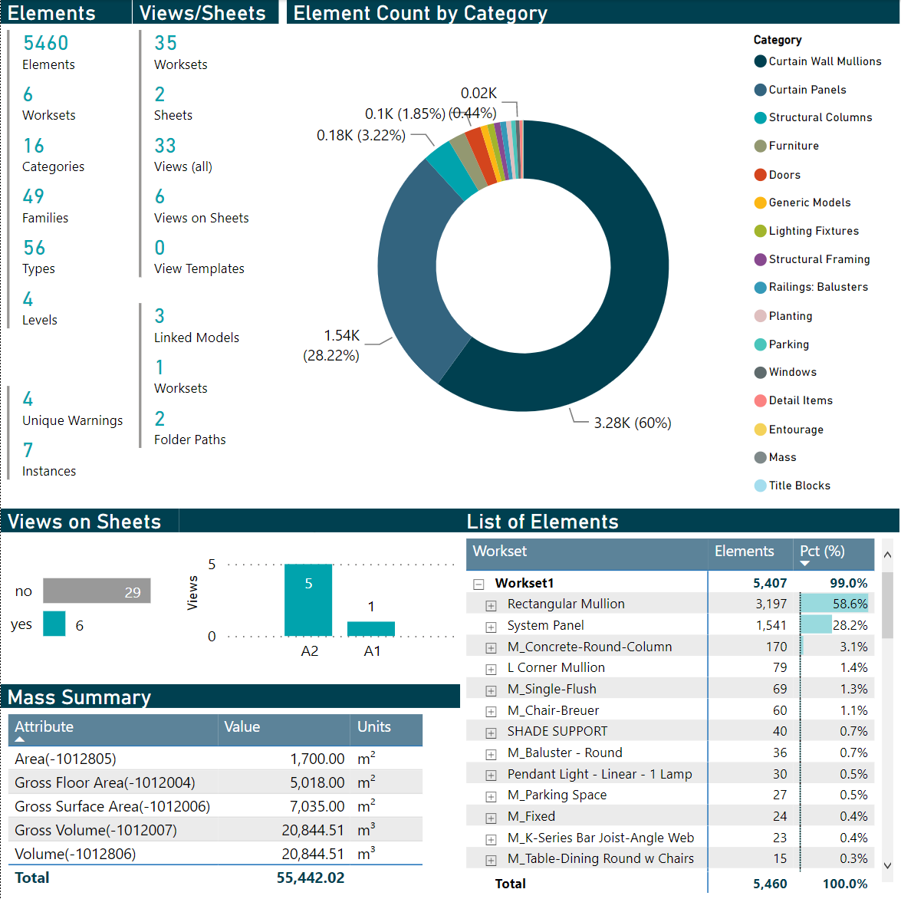
Creating an Actionable Revit Model Diagnostics Tool using Dynamo and Power BI
June 15, 2022
James Feracor, Digital Design Technologist
Sean McDonald, Corporate BIM Manager
Kristopher Dane, Director of Digital Design
Digital Built Week Americas 2022
Anaheim, California

Slide 2
outline
Introduction
Digital Design at Thornton Tomasetti
Speakers
Problem
Solution Outline
Live Demo
Deep Dive into Tool Components
Dynamo
Power BI
Q/A

Slide 3


introduction
Digital Design (D2) at Thornton Tomasetti
Design Practices
Information Technology
Structural Engineering
Construction Engineering
Protective Design
Forensics
Renewal
Digital Design
Why? So project teams can do work that is worth their time; to focus on high value, high impact problems rather than the commodity activities.
Notes:
The Digital Design team that I lead sits at the intersection of IT, CORE (out computational research group) and our business practices.
This means that we
Develop and drive BIM standards and workflows
Interface between corporate staff (departments) and staff working on projects (practices)
Support IT department to streamline technology infrastructure for client work
Develop workflows and policies for standardizing practices
Evaluate and deploy vendor technologies, software, and services
Improve corporate and staff ability to ‘drive with data’
We cover a lot of ground but all of that covers the what and how of our organization which doesn’t get to the meat of D2.
Our Why is:
What? We maintain and implement the tools for collaboration (BIM / Autodesk / etc…). We liaise with other organizations to help connect the needs with solutions.
How? Through development of internal processes, enabling ease of communication of standards, training, and creating tools that drive efficiency.
Why? So project teams can do work that is worth their time; to focus on high value, high impact problems rather than the commodity activities.

Slide 4



introduction
Presenters
Dr. Kristopher Dane
Director of Digital Design
Seattle, WA
Sean McDonald
Corporate BIM Manager
Chicago, IL
Dr. James Feracor
Digital Design Technologist
Seattle, WA
We’re hosting another session tomorrow at 10:45am: 3.2.08 “AirTable for Version Tracking of Revit Details”
Notes:
Kris
Sean
Experience at leading arch and MEP firms, now rounding out experience at structural
Key leader in standard development
Key expert with Dynamo
James
PhD from UW Construction Energy and Sustainable Infrastructure program
Leading thinker in our embodied carbon commitments
A key enabler, driver, and strategist on our next level data platform.
I am going to frame the challenge and then you’ll hear from both Sean and James on the technical details of the solution we’ve developed.

Slide 5
The Problem
Model Review is Hard
Some questions for models
Checking Revit models is resource intensive!
Time-consuming, tedious, and inconsistent when performed manually
Not easy to query / search elements in model using Revit UI… and tons of elements!
Need ability to diagnose model health quickly, consistently, on demand
Checks yield info valuable in diagnosing potential model issues / measuring model health
How many sheets do I have?
How many views are on sheets?
Are the right kinds of things in the right views?
Are objects in the correct worksets?
How much and what kind of stuff so I have in my model?
What are the design quantities of the model elements?
Can I dump model data to Excel for further analysis?
Notes:
Now these questions are simple to get use started.
The more sophisticated questions will be driven by your firm’s standards, workflows, and current training emphasis.
Precisely a problem D2 should work on, as automation can really help:
Minimize data processing time and maximize user time for data consumption/interpretation
This is a classic problem of valuable data existing somewhere
The process of extraction isn’t inherently difficult
but is not valuable b/c resource intensive

Slide 6



Solution walkthrough
x5
TASK 1:
Dynamo Scripts -> JSON files
User manually triggers Dynamo scripts…
POWER QUERY EDITOR
TASK 2:
Update Power BI Template
to read JSON files + refresh data
Power BI Template ingests data automatically!
TASK 3:
Customize Report for intended end users in Power BI
DATA MODEL + REPORT EDITOR
TASK 4: (Optional)
Improve workflow for repeatability
End users consider opportunities to scale + streamline workflow
We’re going to make solution available to all of you (via GitHub)!

Slide 7
Live Demo
Notes:
James/Kris

Slide 8
Aspects to cover in the live demo
Report Walkthrough
Overview Page (Start Here) – summarizes each data set, including warnings and links
Views/Sheets – Details for sheets and views, including those not on sheets
Element Data – split into qualitative, quantitative data
Usability Features
Click items in a visual to filter other visuals on the screen
Exporter Sheets – make your data modular + accessible
Export the data from any visual, including filtered results
Hidden Sheets – Template Pages, Buttons
Notes:
@kdane to think about the walk through script
Make sure that we show that the graphics are linked to gether (click on one)
Show drill through (clikcon the see “DT Example”)
I want to know this
Answer the questions which motivated the problem statement in the Live Demo

Slide 9
revit model
Notes:
Who?
Mins?

Slide 10
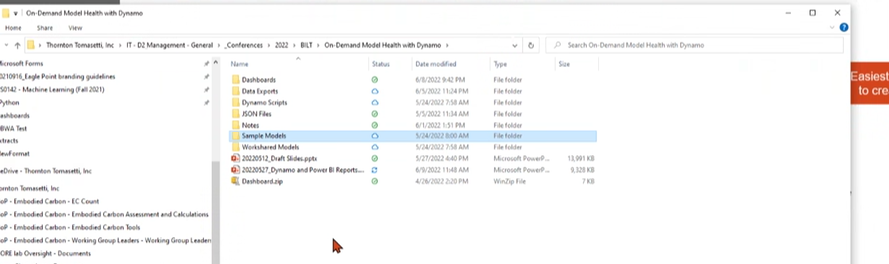
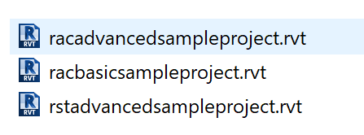
The model
Sample advanced arch (in the folder on teams)
Add worksets
Linked adv struc
Linked basic arch
Broke some things
Bad link model
Duplicated objects to get warnings etc.
Blank sheets etc.
Some view
Notes:
@kdane to add

Slide 11
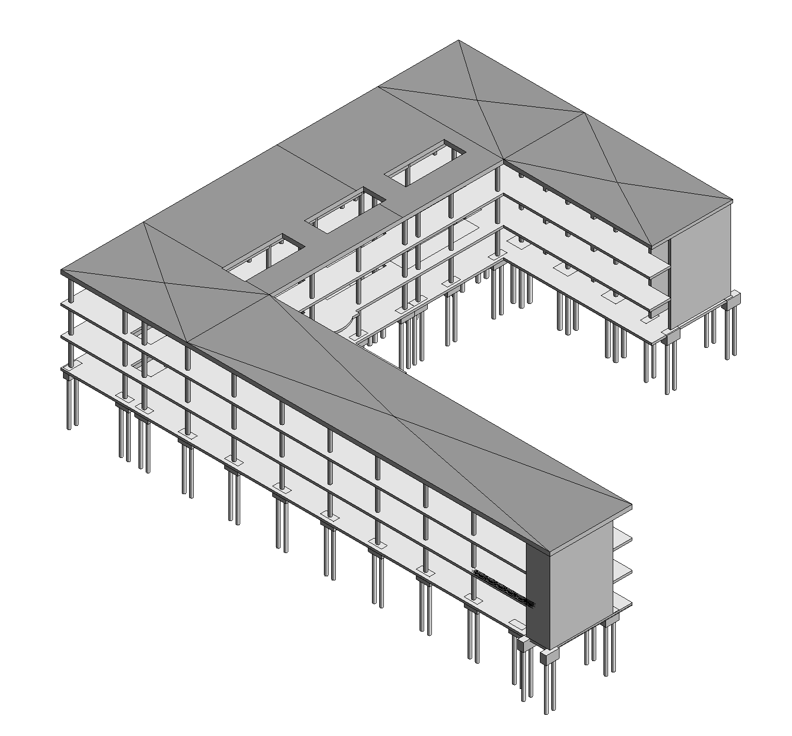

The model
Revit Sample Models
Notes:
@kdane to add
Sample advanced arch (in the folder on teams)
Add worksets
Linked adv struc
Linked basic arch
Broke some things
Bad link model
Duplicated objects to get warnings etc.
Blank sheets etc.
Some view

Slide 12
Dynamo scripts
x5
POWER QUERY EDITOR
REPORT EDITOR
Notes:
Who?
Mins?

Slide 13
Why Dynamo
Why Dynamo
Its free and installed with Revit
“Easily” modifiable
Drawbacks to Dynamo
It can be slow
It needs to be run manually
It can be prone to issues
Issues can be machine specific
You can’t stop a run without killing Revit

Slide 14
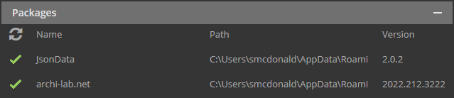
Requirements
Packages
JsonData Exporting Revit data to JSON
Archi-lab.net Element selector Linked model info
Sample Files
Creating using the Autodesk Revit Architecture and Structure sample files (both basic and advanced)
Modified slightly and linked to make the data export slightly more realistic
Revit
Sample made using 2022.1.2

Slide 15
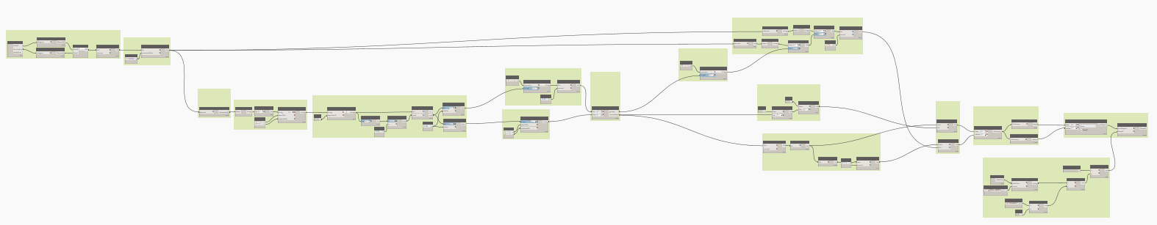
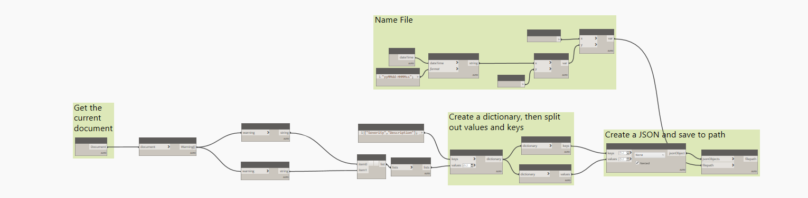
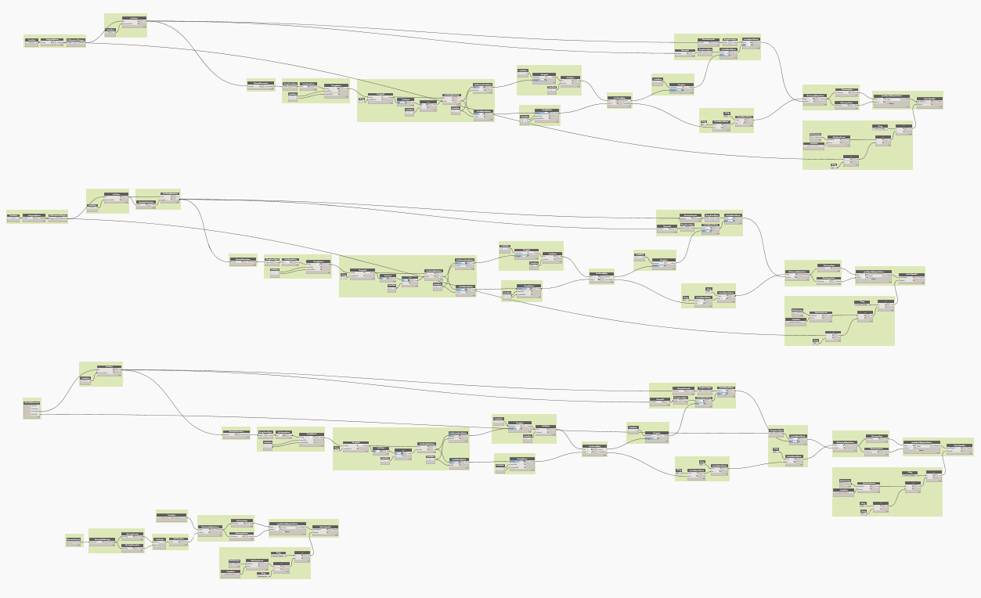
the scripts
Script 1: Elements
Script 2: Filedata
Script 3: Links, views, sheets
Notes:
We tried to choose a method that would be easy to understand and modify. Yes, this could be done with fewer nodes or done more efficiently. We tried to make it easy to understand and modify. And … it worked and I got tired of improving it kuz I lazy.

Slide 16
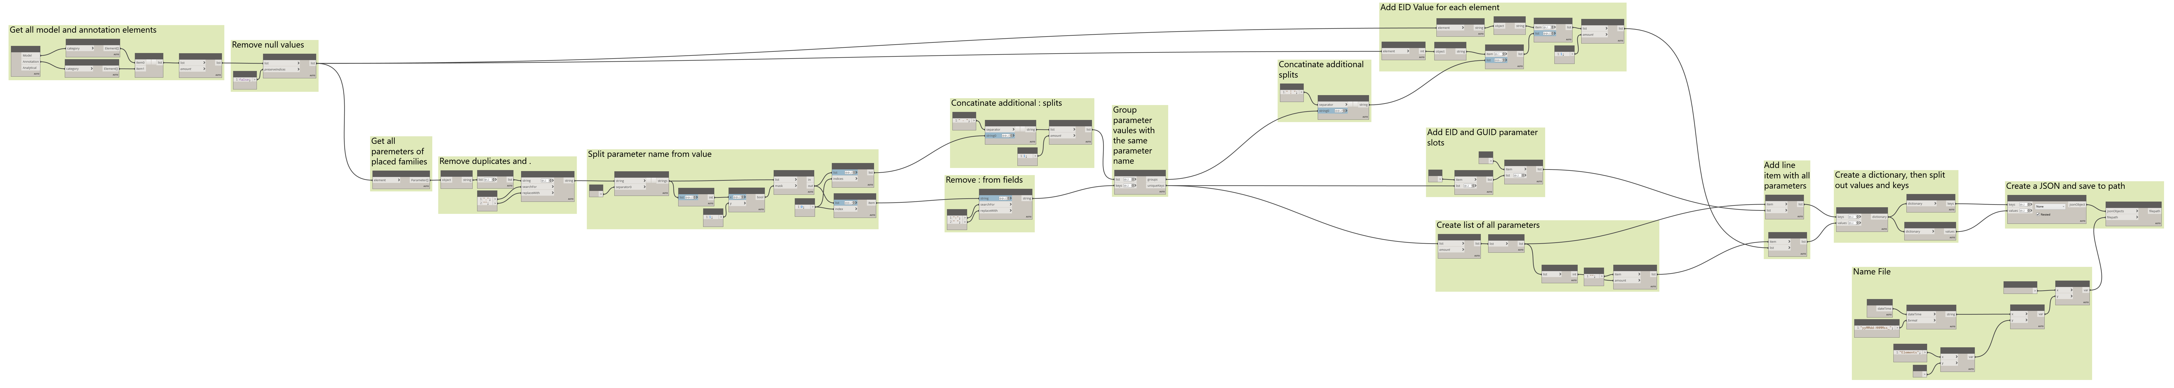
Element Data
Notes:
We tried to choose a method that would be easy to understand and modify. Yes, this could be done with fewer nodes or done more efficiently. We tried to make it easy to understand and modify. And … it worked and I got tired of improving it kuz I lazy.

Slide 17
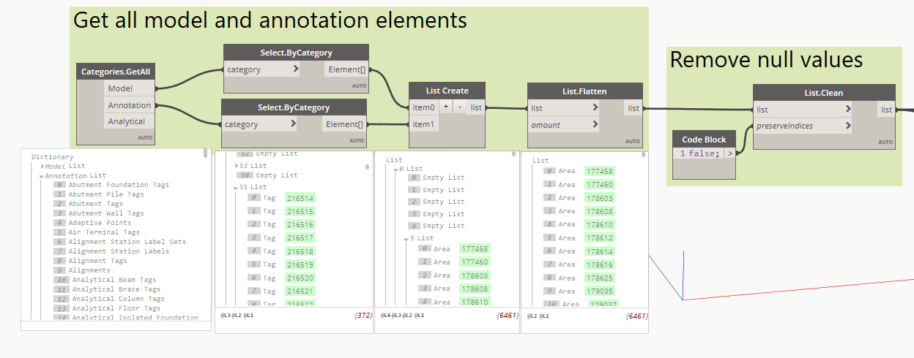
script 1 | Element Data
Using archi-lab.net collector to get all model and annotation categories list
Selecting all elements by category using those categories
Flattening and cleaning the list of elements
Notes:
Selecting the elements can be done a number of ways.
This is a brute force method. A more targeted method may be beneficial if it will increase the speed of the extraction w/o loss of data that is going to be used.

Slide 18
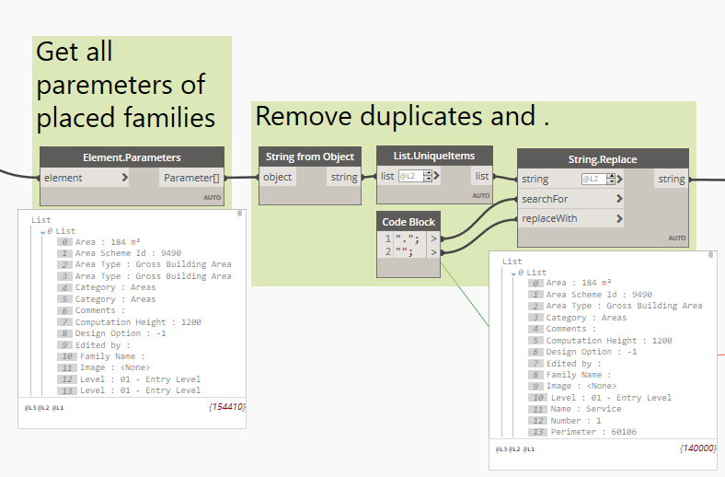
script 1 | Element Data
Get all parameters from the list of elements
Convert to string and remove duplicate items
Replace any . with a space (can interfere when exporting)
Notes:
Again, this is brute force. A more target selection of parameters may be quicker and still yield the desired results.
Removing the . helped get a more consistent result when exporting
Maintaining the “Levels” becomes very important from this point on

Slide 19
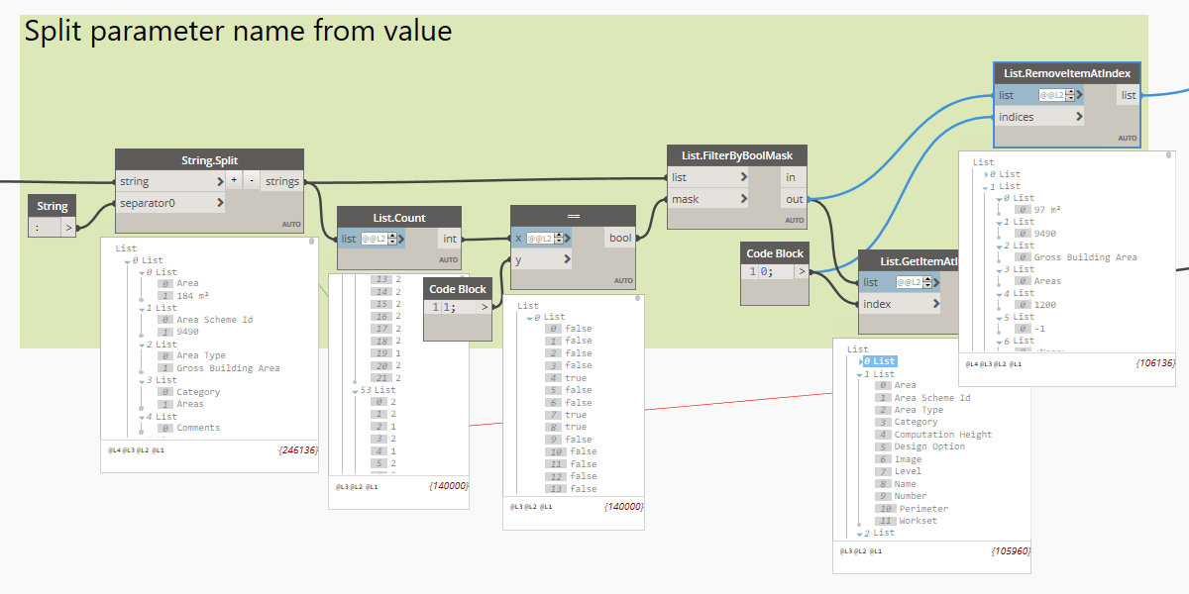
script 1 | Element Data
Split the parameter fields at the : to get the Parameter and the Value
Using the count of elements in the list, empty values can be filtered out
Both grabbing and removing the elements at index 0 will create the 2 lists (parameters and values)
Notes:
The mask by count and get/remove by index 0 is to allow for values that may have been split additional times buy the : in the previous step. Removing items at index 0 also keeps the values list group in the event of the additional splits from the :

Slide 20
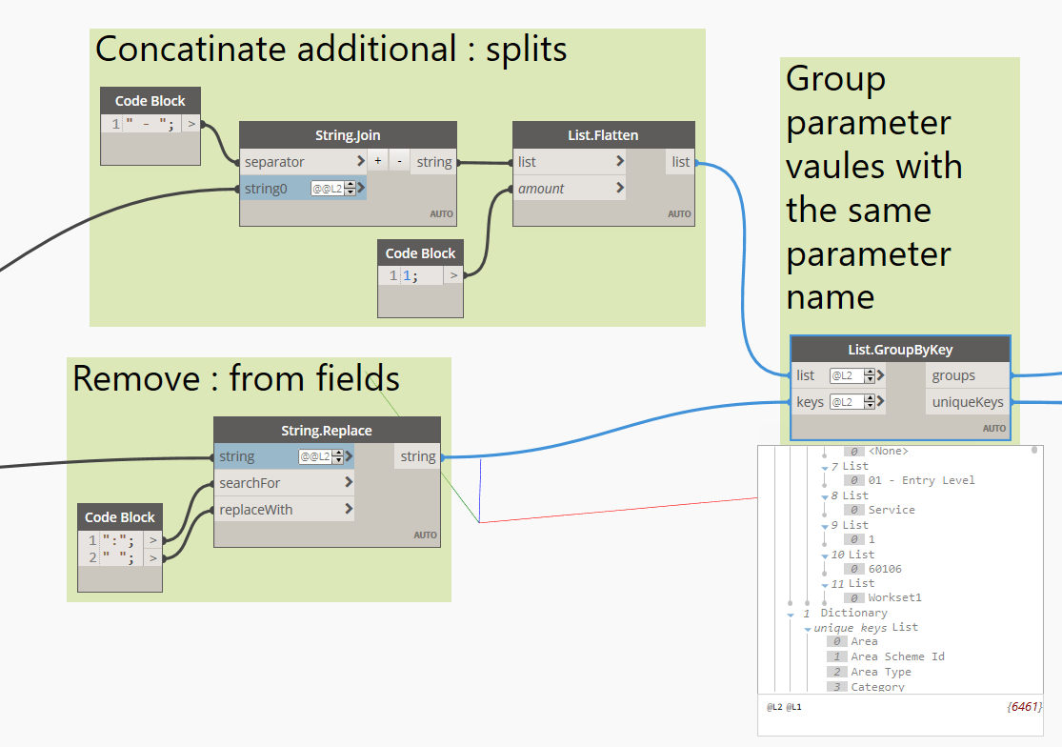
script 1 | Element Data
Join any values that may have been split
Remove any : left in the parameter name
Group all the values by parameter name
Notes:
As mentioned previously, values may have been split additional times due to having a : in the value. This will join them. A – was used, again, this yielded less issues than a : when exporting the JSON
In the parameter name, : may be left because we split by space : space. Again these colons are removed to improve the JSON export
Next we need to group the values by the parameter names. This is because we may have several parameters with the same name in the Revit model, but they may have different values. We will be sending this into a dictionary in a later step, so the “keys” need to be unique. Originally, we had played with prefixing the parameter names with their ID. While this did work, it made the data harder to work with and did not improve the quality of the data in any meaningful way. By joining them up with a unique delimiter we can split them back out in PowerBI later if we want to.

Slide 21
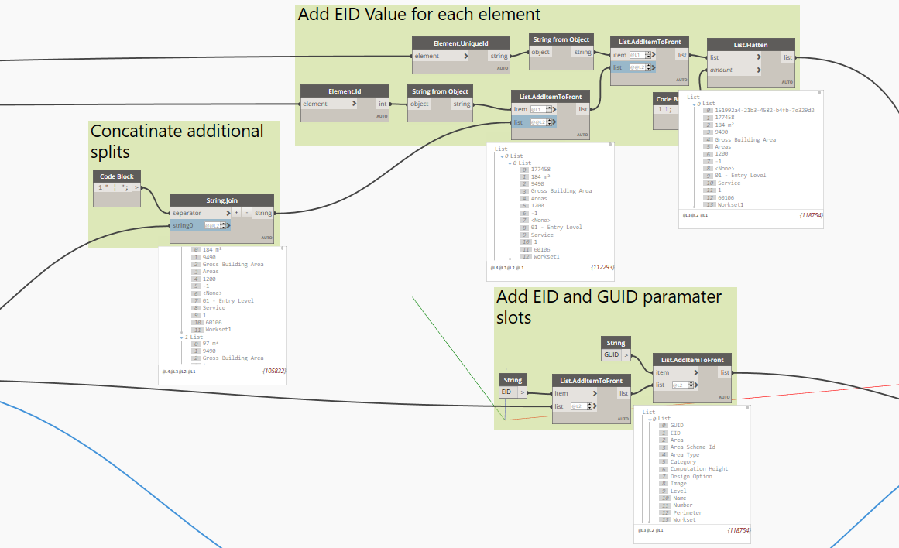
script 1 | Element Data
Join the values for parameters with the same name
Add the element ID and GUID values to the front of each element
Add the elements ID and GUID keys to each parameter list
Notes:
Here is where we join those parameters with the same name. We are using a delineator that will be easy to identify, and unlikely to be in any values, in case we need to split them back out later.
Next we are prefixing the list for each element with the GUID and Element ID. These are also added to the “keys”

Slide 22
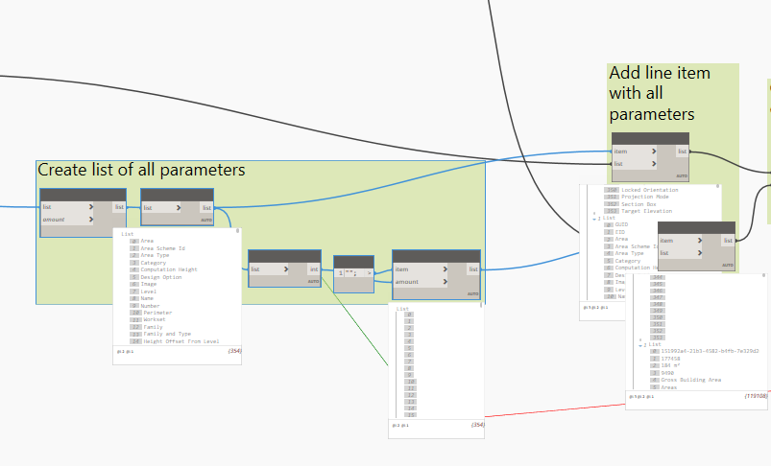
script 1 | Element Data
Create a list of all parameters
Create blank values for the list of parameters
Add these to the front of the values and keys lists
Notes:
This step was added when we noticed an issue arise with very large models. The JSON file stores the parameters associated with each element. PowerBI takes a sample of the first 1000 elements and builds the parameter list from that sample. If a parameter does not show up in the list by the 1000th item it will not appear in PowerBI. By putting the full list of parameters at the front of the JSON we ensure PowerBI gets them all. This line can be removed in PowerBI once the JSON is loaded.

Slide 23
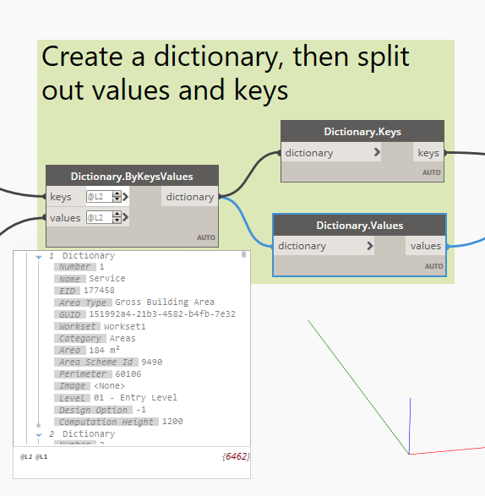
script 1 | Element Data
Create a dictionary with the parameter names and parameter values
Grab the dictionary Keys and Values
Notes:
We will be using the dictionary to JSON node from the JsonData Package. This created the cleanest results.

Slide 24
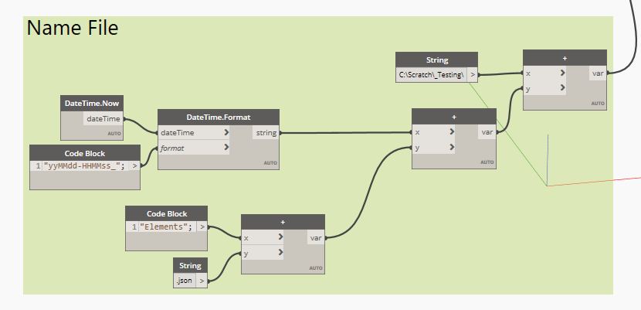
script 1 | Element Data
Create a file name and path string
Notes:
To help keep the files easy to identify we are saving them in a consistent path with a preset name prefixed with the data and time.

Slide 25
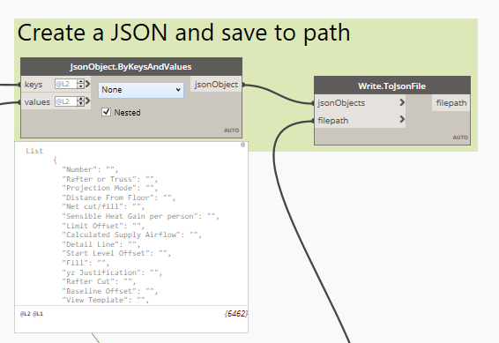
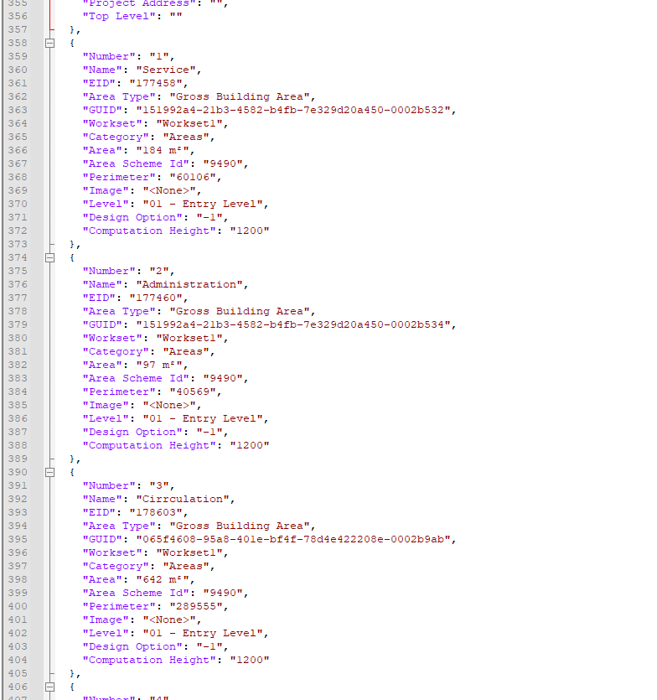
script 1 | Element Data
Convert dictionary keys and values to a JSON object
Write out the JSON
Notes:
Use the JsonData node for dictionaries to format the JSON and the write JSON node to save the file

Slide 26
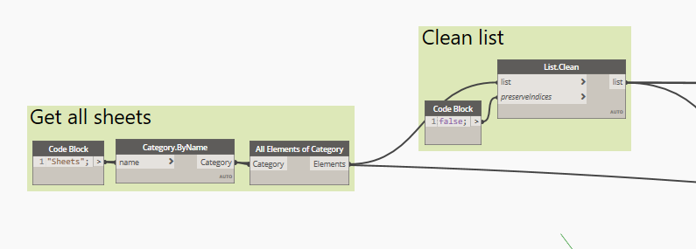
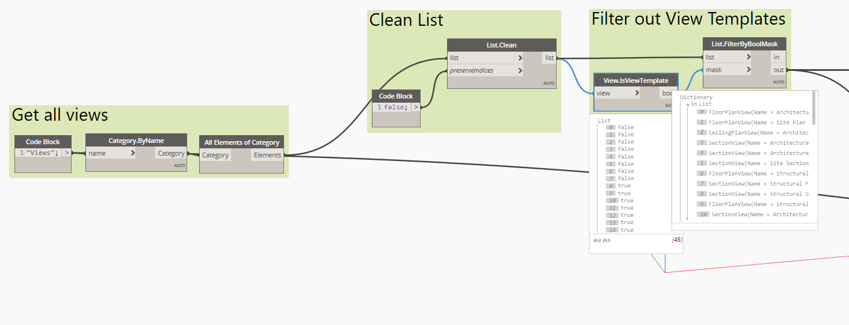
script 2 | Sheet / View
Select by category for both views and sheets
For views, filter our view templates
Notes:
Similar to the elements, selecting all elements by category. Only by manually naming the category. I have found the graph will last longer if you do category by name as opposed to the dropdown (as what shows up in the dropdown will change in different versions).
Views has an additional step of filtering out all the view templates.

Slide 27
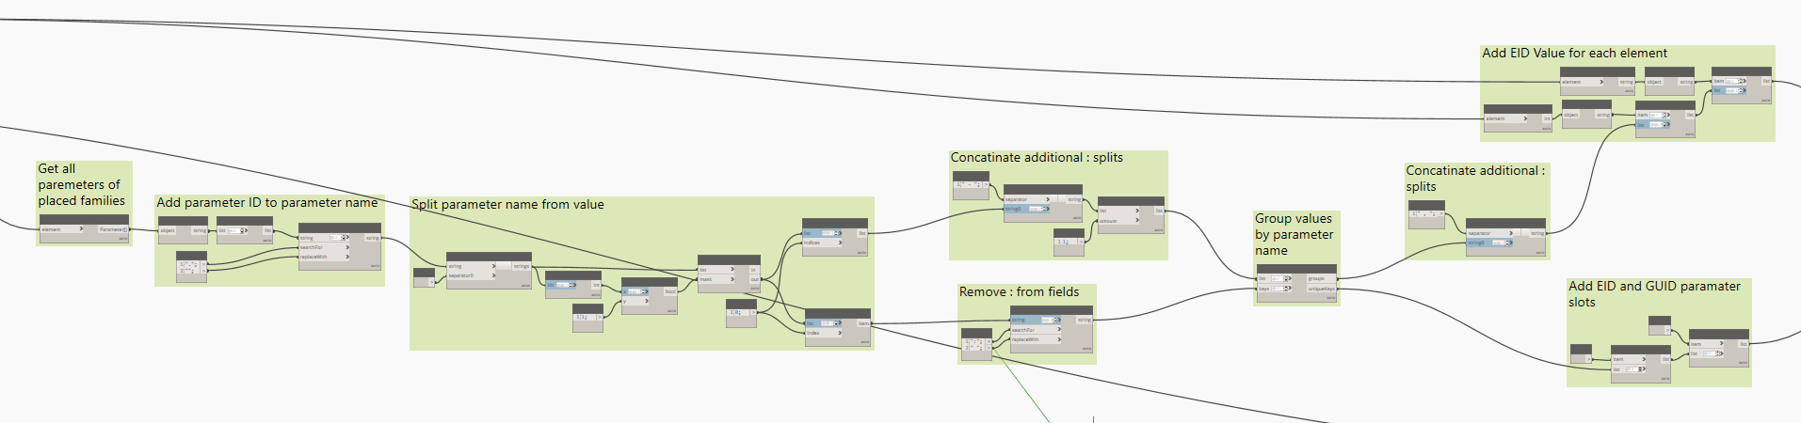
script 2 | Sheet / View
Center of the graph is identical to the elements graph
Notes:
This is simply a copy and paste of the guts of the elements graph. Works for both the views and sheets (if it aint broke don’t fix it). Once this section is how you like it, creating a custom node for it may be useful if you want to pull several more JSON exports.
Adding the consolidated list of parameter names was omitted from these graphs since the parameter name will be consistent for all elements in the lists (they are all the same category).

Slide 28
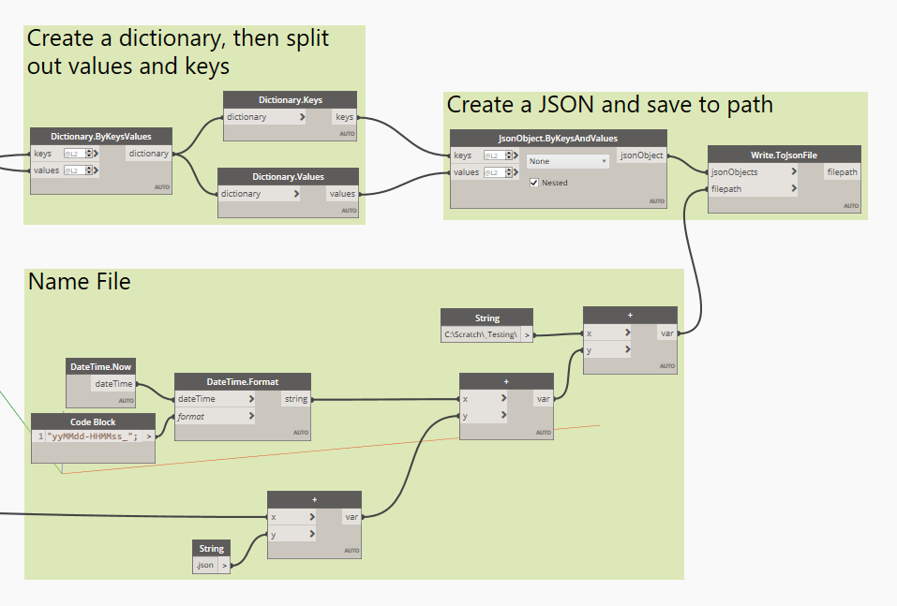
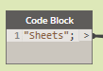
script 2 | Sheet / View
Create dictionary, create JSON and export are all the same from elements graph
Connected category name to file name
Notes:
The conversion and export method is identical to the elements graph as well.
From the file name string generator, it is connected directly to where the category name was written. That way (at least for the sheet version) different categories can be saved simply by typing a new name in that field (view has the extra view template mask).

Slide 29
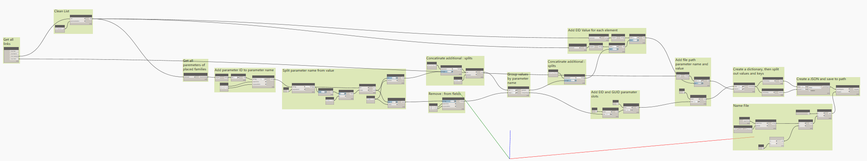
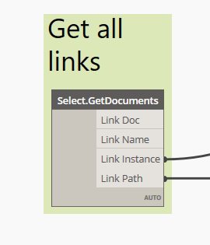
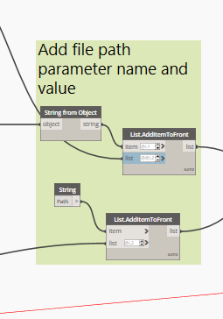
script 2 | Links
Most of the links graph is the same as views/sheets
Exceptions
Get links using archi-lab.net node
Add the link name and path to parameter list
Notes:
Links works just the same as sheets and views. The only exceptions are, to grab the file paths, the archi-lab.net node is used.
Since we are using it, and it is giving all the link instances anyway, we are just passing that to the main body of the graph.
Just before we create the dictionary, we are adding the path parameter name and value back into the elements list.

Slide 30
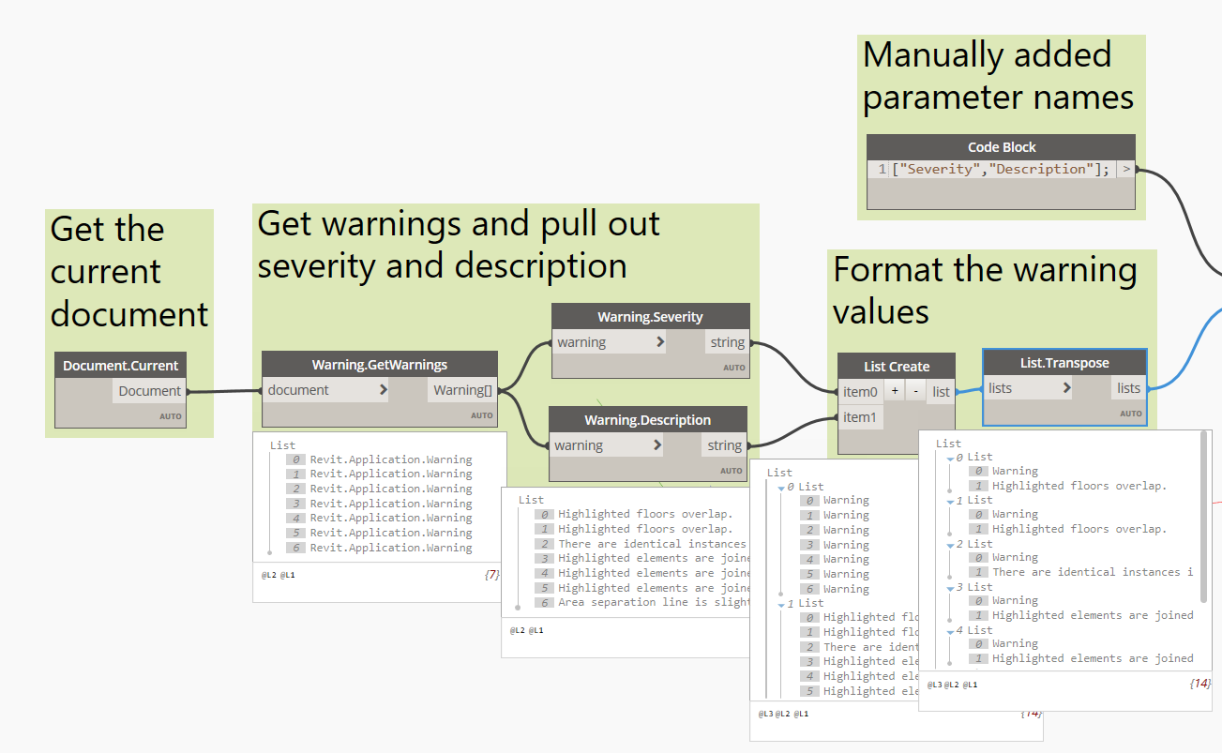
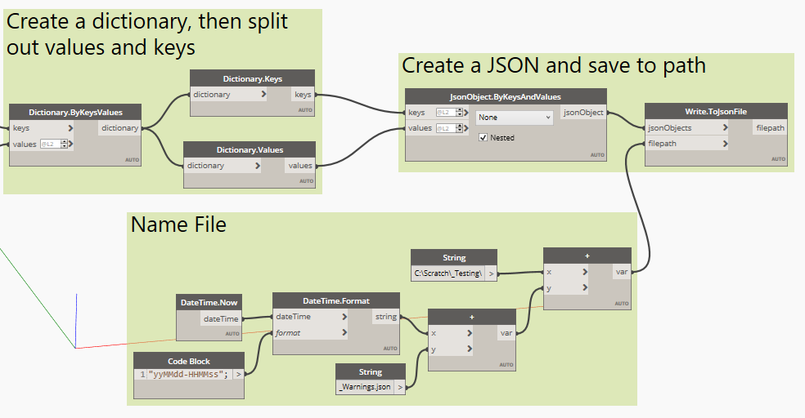
script 2 | Warnings
Use GetWarnings node to collect warnings
Extract the severity and descriptions
Reformat the list
Creating dictionary, JSON format, and file export are the same
Notes:
Again, similar formatting.
Using the dynamo warning collector extraction nodes to collect the data, reformatting it to be grouped by warning, and adding it to the dictionary.
The dictionary creation, JSON formatting, and file export are exactly the same as the previous examples

Slide 31
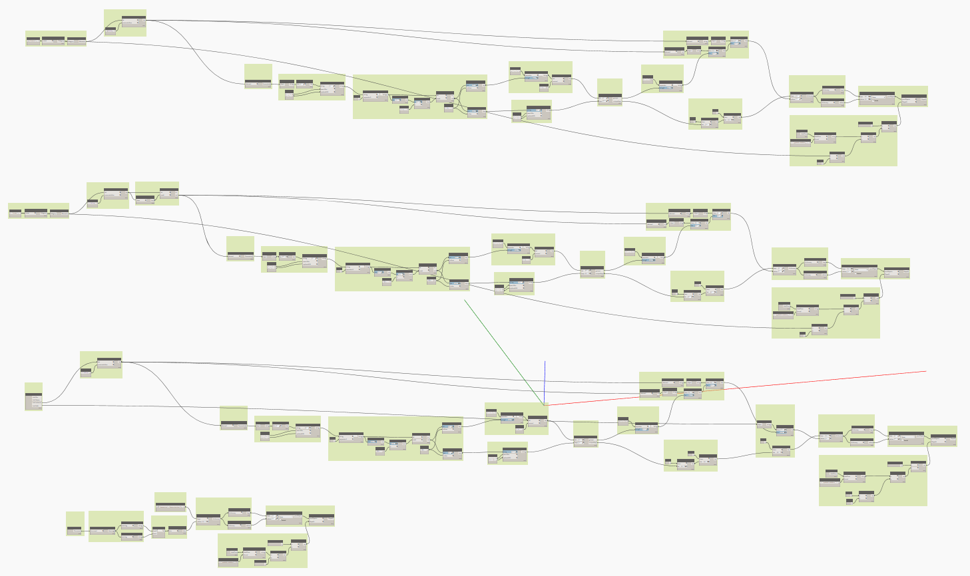
script 2 | Sheet / View / Link / Warnings
To save time, sheets / views / links are in the same graph
Notes:
All of these are in the same graph so they can all be run at once. With more complex list manipulation they could be combined. But, as stated previously, I am lazy. Additionally, I have found that complex list manipulation can cause the graph to take much longer to run.
Elements was specifically excluded from these as it alone will take a long time to run. Ran on a large airport project and it took half a day to run the element. All the other graphs combined run in under 5 minutes.

Slide 32
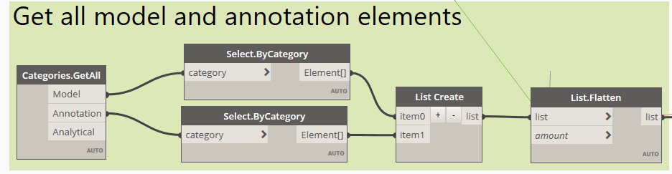
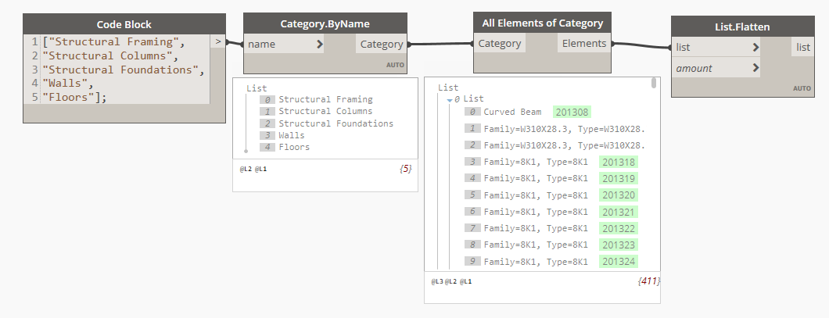
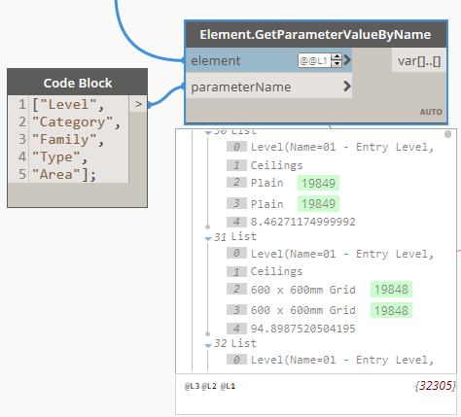
script 2 | Customizing the Script
Speed
Limit the extraction to model or annotation elements
Limit the extraction by category
Consistency
Limit the extraction to specific parameters

Slide 33
Expanding the Script(s)
Elements in view
File/ Project level info
Loaded, unplaced content
Overlapping elements
Geometry data
Notes:
I selected what I did to extract because it encompassed a lot and was consistent in method. Additionally, apart from a couple of nodes that came from well known packages, there was no custom nodes/python nodes/scripting.
This could very easily be expanded to grab additional data.

Slide 34
Import data into power bi
x5
POWER QUERY EDITOR
REPORT EDITOR
…as an end-user
Notes:
Power User
Goal is to show you use Power BI as an end-user / consumer, not a developer
We share a few points about development, so you understand what’s going
If you are developer, you can further modify report

Slide 35
Why power bi?
TT delivers data via Power BI platform
Shifts focus from processing to consuming / interpreting data
Desktop
Consistently clean and process model data automatically
Powerful beyond Excel…and Revit UI sucks for analysis
Desktop App is free and comes with most features (try before buying Pro)
Self-service tool empower users, does not require process ownership
Pro (and higher)
Collaborative features - web-based and centralized access (single source of truth)
Integrates well with Microsoft products, especially Teams and Sharepoint
Scheduled data refreshes to optimize workflow for end-users
Notes:
Other technical points:
Based on philosophy of generalizing data to answer multiple questions, rather than one specific one
Leave source data untouched – all transformations occur in Power BI
All transformations are programmatic – all end users get them, and the steps are stored in the template themselves
End users dealing with instance of report, not the original one (can’t accidentally change things)

Slide 36
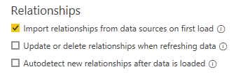
Preparation Checklist
Check your version of Power BI
Template made w/ May 2022 update
Power BI not backwards compatible for this version, so must use this version or later
Organize JSON files into single folder
When using Power BI template…
Turn off Auto-Detect Relationships
Power BI frequently and incorrectly tries to relate tables
Unexpected relationships can over constrain model and create refresh issues
Turn this off (if not already turned off)
File > Options and setting > Options > Current File: Data Load
Notes:
Notes re: folder creation
All files should go in a single folder or subfolder
If there are extracts from multiple snapshots, call the most recent file the same thing (e.g. ProjectName_Views.json)
To keep older extracts, recommend prefixing older files with ISO formatted date and move to an archive subfolder, e.g.
(rename file 20220601_ProjectName_Views.json and place in _archive subfolder)

Slide 37

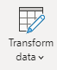
Anatomy of Power bi
What the developers sees (PQ) versus what the end user sees (report editor)
Roles
Developer
End-User / Consumer
Primary Sections in Power BI
Power Query Editor
Transform and optimize the flow of data that all users will consume
Report Editor
Define the intended user experience,
customize the display of information
Intended purpose
Process data so end users don’t have to
Make reports useful and usable
Subsections
Report View
Create and format visuals
Data View
Available data as a table
Model View
Table relationships
Notes:
Power BI effectively has 4 views, but most are for developers
Advanced knowledge of Power BI not needed to use template… but it can help you further refine it
Power Query Editor
‘If all end users would benefit from a data transformation, it goes here’
Ingest + transform the underlying data sources before visualization
Add/remove columns, combine tables (merge/join, append)
Parameterize file names and manage credentials for source
Create reusable functions
Report Editor, which has 3 sections. Effectively, this is where the user experience is defined in Power BI.
‘In addition to perceived usefulness, reports must also be perceived as usable’
Data Model
Define relationships between tables
This affects how filters/slicers operate on data
Data View
See data available to report as tables
Create calculated tables, columns, and measures
Report Editor
Create and format interactive visualizations
Control usability features (slicers, appearance, interactivity) + aesthetics

Slide 38
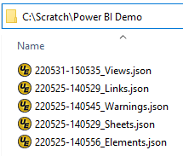
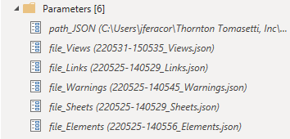
LOAD JSON Data into Power BI
New users only need to load data; advanced users may further customize
New Users:
Point the tool to the 5 JSON files in Power Query. Done!
Advanced Users:
Load more data, perform additional data transformations (e.g. joins, merges, delete unused columns, change column formatting)
Put your JSON files in a folder…
In the Power BI template, there are 6 ‘Parameters’ in Power Query editor you need to provide inputs for:
path_JSON
file_Views
file_Links
file_Warnings
file_Sheets
file_Elements
Notes:
Power Query Editor
Basic Users: All you need to do is provide the name and path of your JSON files. That’s it!
Advanced Users: perform additional transformations based on your comfort level
Data Model + Report Editor
Basic Users: Refresh your data. Adjust format of visuals, add/remove columns from tables
Advanced Users: Add new calculations, tables, visualizations; create more advanced usability features

Slide 39
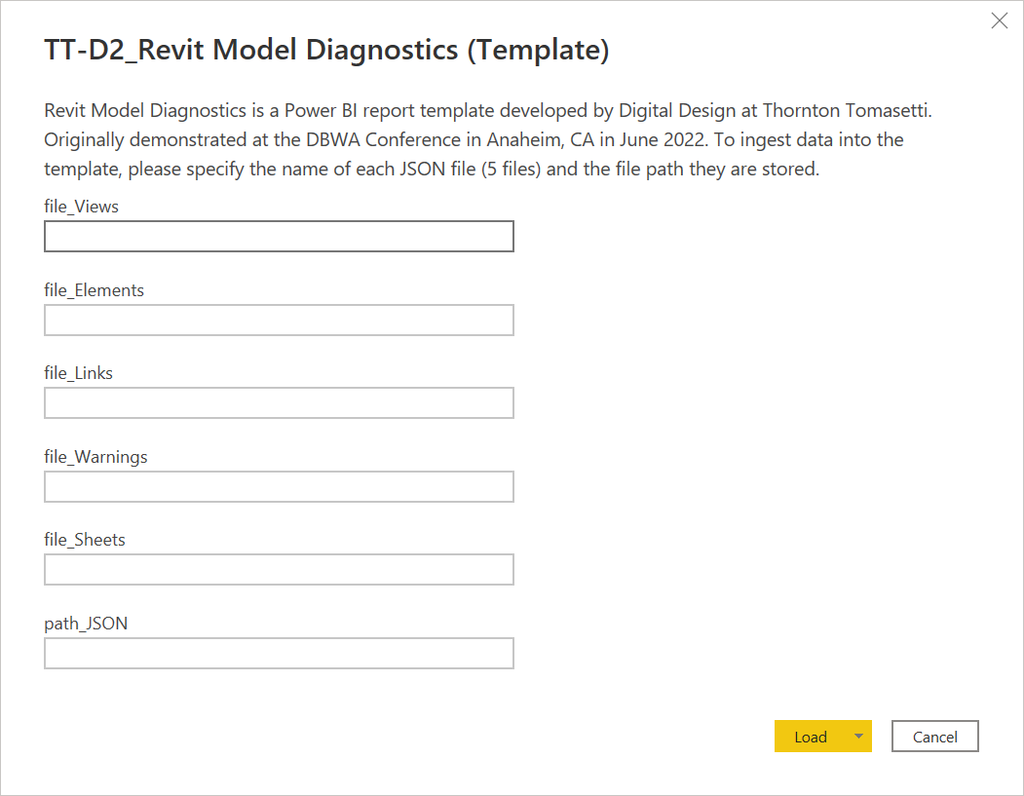
LOAD JSON Data into Power BI (cont.)
New users only need to load data; advanced users may further customize
New Users:
Point the tool to the 5 JSON files in Power Query. Done!
Advanced Users:
Load more data, perform additional data transformations (e.g. joins, merges, delete unused columns, change column formatting)
You will be prompted to enter these parameters when you open the template for the first time
file_Views
Edit the values to match the name of your JSON file + folder path
file_Elements
file_Links
file_Warnings
file_Sheets
Press ‘Load’ when done
path_JSON

Slide 40
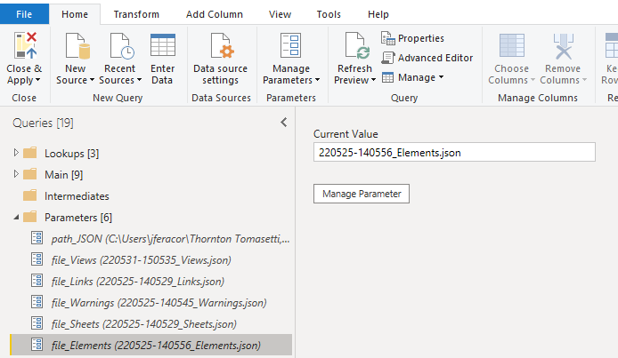
LOAD JSON Data into Power BI (cont)
ADVANCED TOPIC
If you want to modify the parameters in the future…
(4) After updating all [6] parameters, press ‘Close & Apply’ (top left icon)
(2) …then edit the value to match the name of your JSON file (or folder path)
(3) repeat step for the other 4 JSON files + the parent folder path
path_JSON
file_Views
file_Links
file_Warnings
(1) Click on a parameter to see its current value in the pane to the right…
file_Sheets
file_Elements
Notes:
If this isn’t your first time opening the template, then you can also edit the parameters at any time.
You just won’t get the nice prompt in the previous slide.

Slide 41
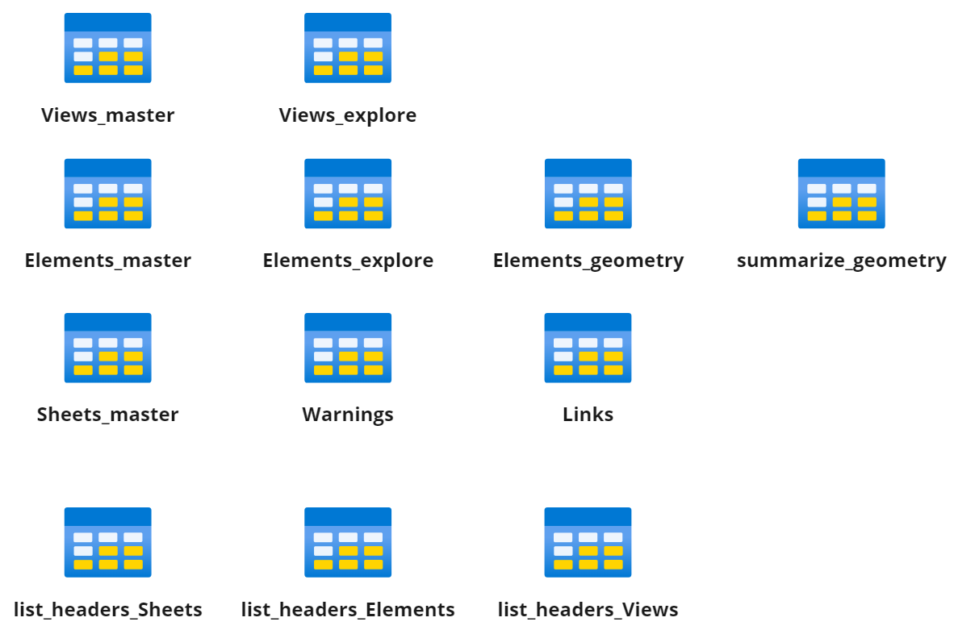
LOAD JSON Data into Power BI (Cont)
ADVANCED TOPIC
Query folders are optional, but help you stay organize
Main
Parameters
Primary data tables used to create model + report visuals
Parameters that allow you to swap while JSON files are loaded into the report (from previous slides)
Query Errors
Summary of errors that may have occurred when loading your data
Lookups
Intermediates
Incoming
(Optional) for header tables. Can assist with dev
(Optional) A place to put tables necessary for calculations but not needed for any specific visual. For developers.
(Optional) Folder for new queries while in development or scratch work
Notes:
For developers who want to understand how the data is modelled
This is final format of data as they appear in the report
Can delete, or disable loading of tables in PQ

Slide 42
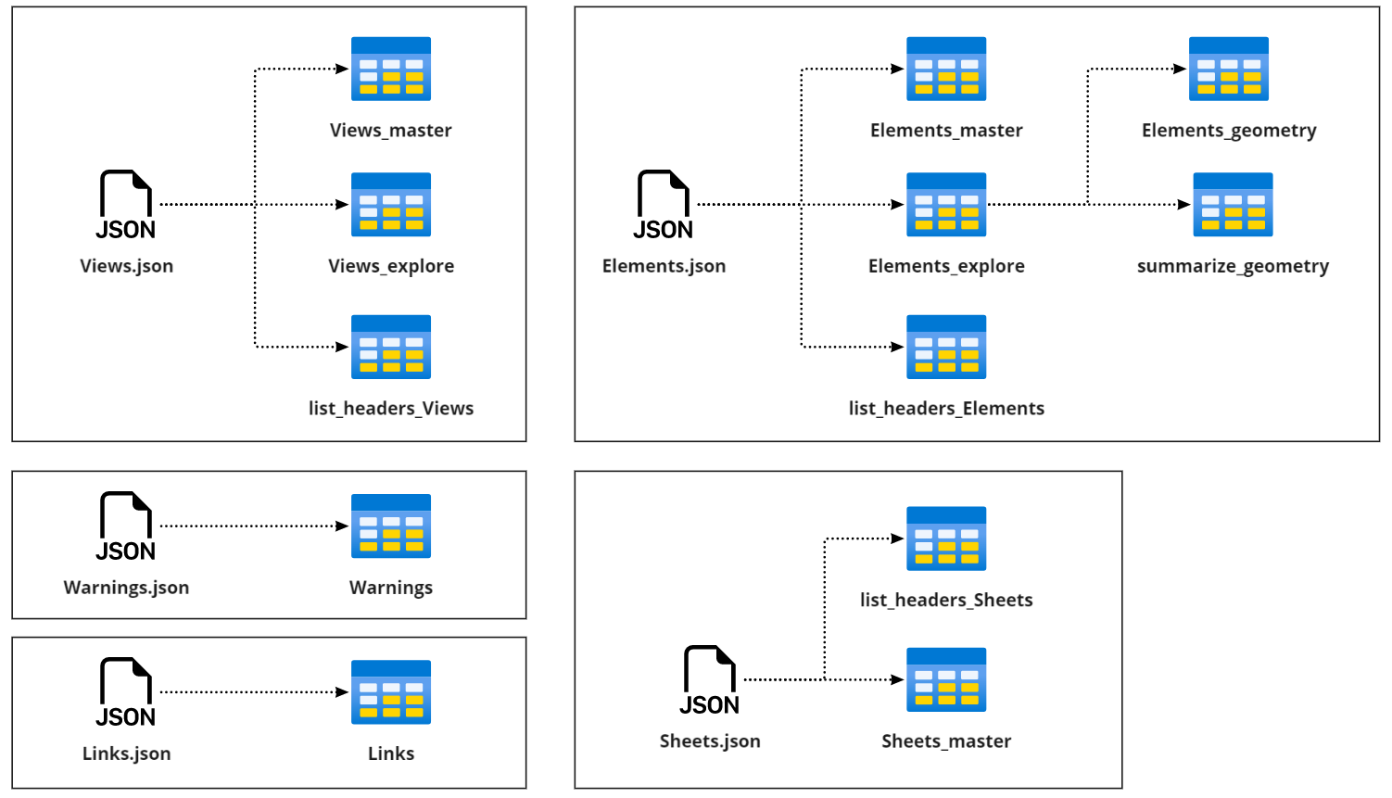
JSON Data Contents
ADVANCED TOPIC
Mapping JSON to Tables
Data Cleaning Steps
Split large tables into components
Clean data for formatting
truncate multi-values cells
consistent values
consistent column headers
separate units from quantities
Summarize tables for visuals
Optional (but helpful)
Generate lists of column headers to assist with development
Notes:
What’s my motivation here?
Best practice to separate identity / slicer columns form attributes or quantitative data
There are many transformation steps all end-users benefit from (save others time)
Chance to modify or replace values based on logic rules
Consistent, repeatable – instructions can be auto-applied to other tables or new data
All transformation steps are included into the template; advanced users can further modify as needed

Slide 43
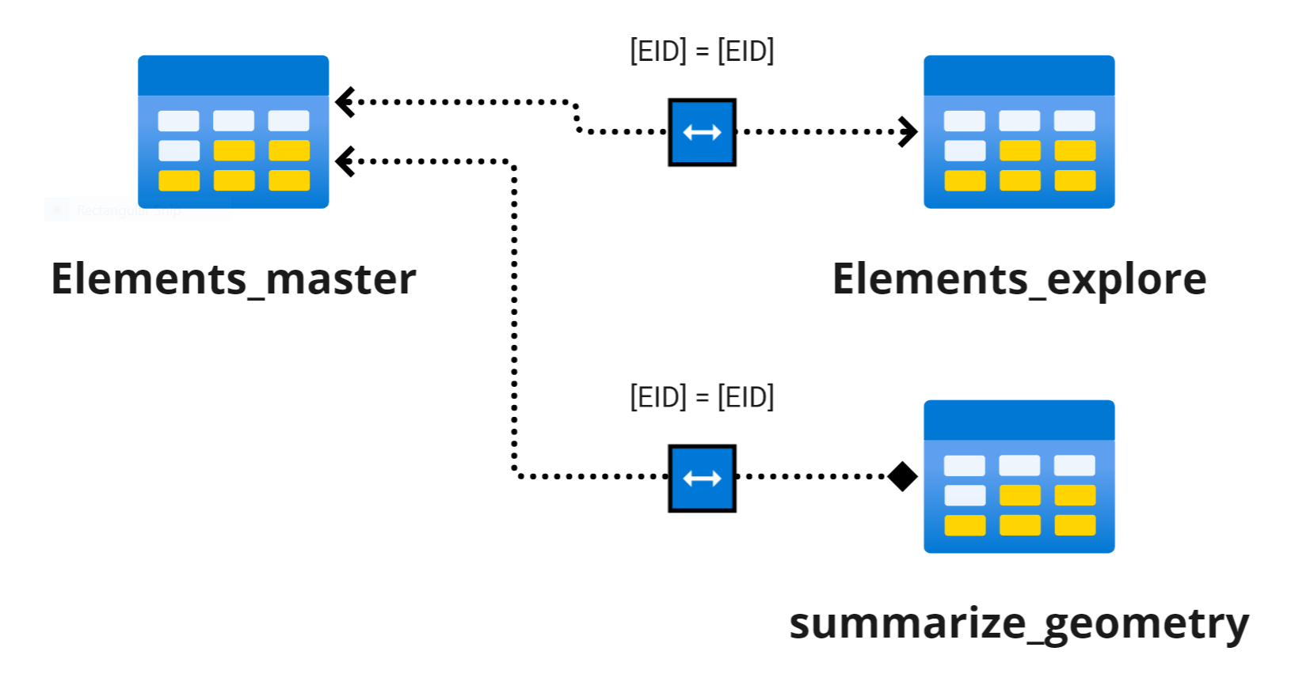
Why do we need to transform data?
ADVANCED TOPIC
Transformations pre-programmed in the template make data tables modular
Steps for Elements_master
1. Load raw data
2. Create duplicate for Elements_explore
3. Remove all other columns except GUID or EID and any columns to be used as slicers for Views
4. Filter any rows not needed
Steps for Elements_explore
Remove all columns used in Elements_master except for GUID or EID
(optional) Reformat columns (e.g. change formats to numbers, separate units from quantities, split, etc.)
(optional) Filter any rows not needed
(optional) replace values for consistency (handle blanks, nulls, white spaces)
All tables based on Elements should be connected to Elements_master via [EID]
Notes:
Discussion Point: Why not leave this as a single big table?
This is ‘star schema’ technique is widely used by data scientists for good reason
If you split the table into more than 2 smaller tables, must use master table as centralized slicer
Your child table may be reshaped where there is no longer a 1:1 relationship with EID
Having too many columns makes it hard to navigate, loads unnecessary data (inefficient)
You are trying to calculate 2+ metrics from a table, but filters may be mutually exclusive (challenging to do simultaneously!)

Slide 44
CUSTOMIZE POWER BI
x5
POWER QUERY EDITOR
REPORT EDITOR
Notes:
Who?
Mins?

Slide 45
Customize Power BI Report
Use Report Editor to align report content to specific needs of intended end users
Use Power BI Report editor to
Two areas of customization to focus on: perceived usefulness, perceived usability
Perceived Usefulness: How useful is data model + data visualizations?
Perceived Usability: Can users navigate it on their own?
Model Considerations
Additional / alternative visualizations (details)
Additional measures, calculated columns, or tables
Key performance metrics
Table relationships (cardinality and direction)
Usability Considerations
Slider syncing / Interactivity features
Tooltips and on-screen guidance
Links to company-specific resources / guidance
Buttons and bookmarks
Notes:
NOTE:
Previously, usability really wasn’t a big concern in Excel because developers cannot easily control the user experience
Power BI shifts this tremendously, so now it really matters.
CEs aren’t used to developing interfaces, so this is where manager /stakeholder feedback can really help
Model Considerations
Additional summary tables + visualizations
Key performance metrics
Usability Considerations
Slider Syncing / Interactivity Features
Additional columns or measures
Tooltips, resources, and guidance to company-specific content

Slide 46
IDEAS FOR Customizations
Add branding and customize aesthetics
Branding and Aesthetics
Users will find report more useful if it feels relevant to specific needs of company
Display information in manner that end users expect (standard metrics?)
Add tooltips that help users interpret what they see
Report Versioning + Control Complexity
Create alternative versions of pages or reports with different levels of detail
Hide details for casual users, but data available on demand
Notes:
Why would you want to customize the template?
Multiple end users with different needs for details
Not all metrics or visuals are relevant to users; some are particularly important
Why answer one question when you can answer all of them?
Familiarity fosters user trust – make something that is recognizable or speaks to their specific needs

Slide 47
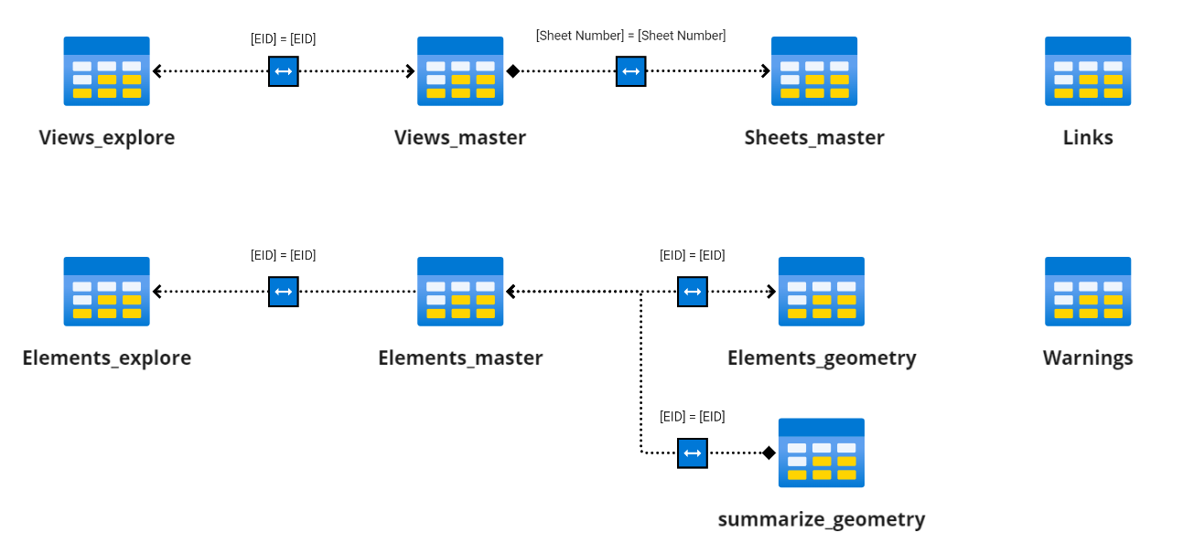
Data MODEL
ADVANCED TOPIC
For developers who want to expand on the template model
Data Model as it exists in the Power BI template
Note that Links and Warnings tables are not connected to the model
Future development could link elements to views and sheets they belong to
New tables based on Elements or Views should be related to their corresponding ‘master’ table
When creating slicers for views or elements, use the ‘master’ table columns
This ensures slicers are synced across pages
Notes:
Tips for Developers
TURN OFF AUTO-DETECT RELATIONSHIPS
Attach a child table to its respective master table to enable centralized slicing
It’s okay to leave tables detached – they don’t need to be related in all cases
Over over-constraining your model – this can mess us future data refreshes (i.e. no more than 1 link between 2 tables)
Avoid creating new tables unless you need to reuse values for multiple different visualizations
If trying to get single value based on context/filters and don’t need to re-use, use DAX measure to calculate

Slide 48
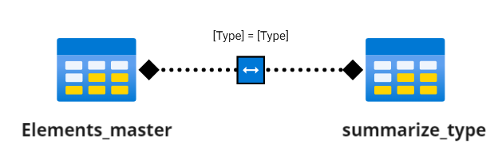
Example Customization #1
Add a calculated table + relate to existing model
Query: Which element types have over 200 elements in the model?
Solution: Create calculated table to filter elements table by the number of elements per category, then use as slicer.
1. Add Calculated Table w/ DAX
2. In Model View, relate summary table to master table on [Type] field (both directions)
summarize_type =
SUMMARIZE(Elements_master,[Type],
"Elements", COUNT(Elements_master[EID])
)
Notes:
Technical Explanation:
Without table, we could calculate the total number of elements
However, the totals by type are calculated in real time, not saved in memory
Hence we cannot query or search for element types based on the total count
Thus, must make a separate ‘summary’ table to make these values filterable / searchable

Slide 49
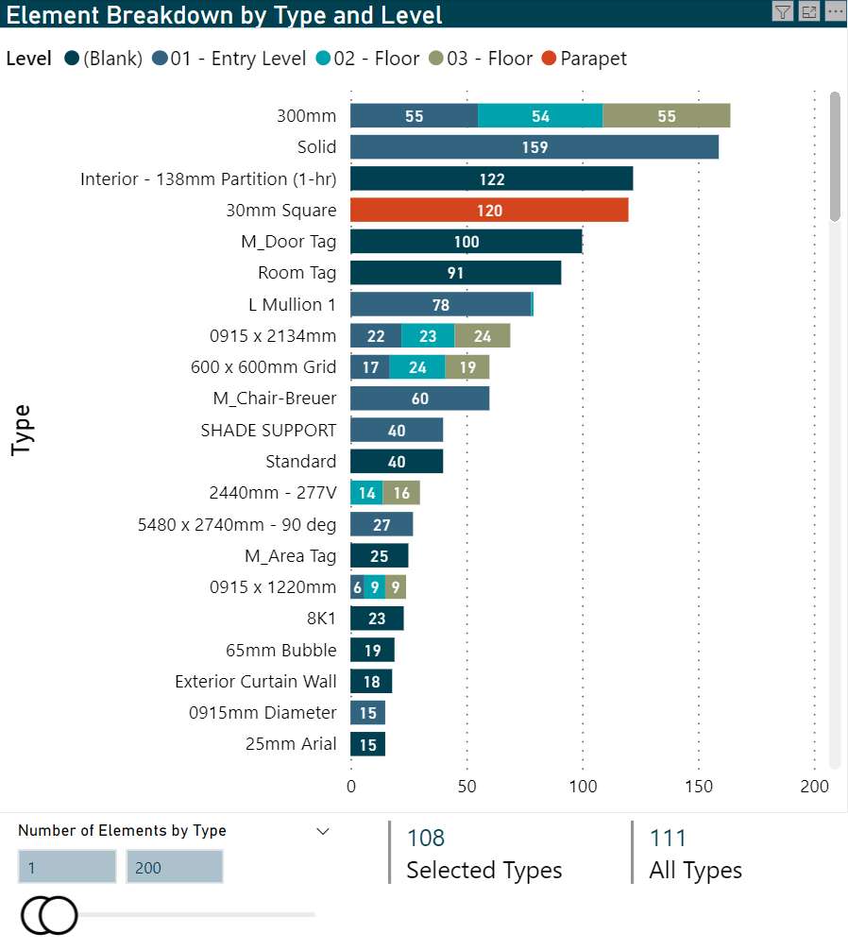
Example Customization #1
Add a calculated table + relate to existing model
Query: Which element types have over 200 elements in the model?
Solution: Create calculated table to filter elements table by the number of elements per category, then use as slicer.
ANSWER:
108 types w/ <200 elements
3 types w/ 200+ elements

Slide 50
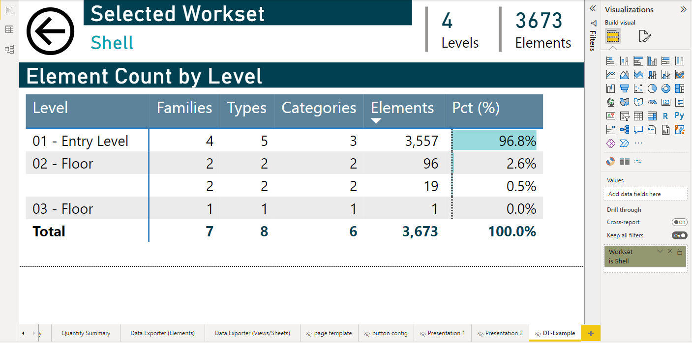
Example Customization #2
Add a drill through page
Query: What is the distribution of elements by Level for a selected Workset?
Solution: Create drill-through page with specific view user expecting
2. Under ‘Drill through’:
Turn ‘Keep all Filters’ on
Add ‘Elements_master’[Workset] to filter (MUST be column as table)
Back button automatically created when you add a field to Drill Through
1. Create a new page Make sure it is hidden (I called mine “DT-Example”
Notes:
Technical Explanation
Let’s say there is a table or viz available when someone searches for a specific workset (i.e. count of elements by floor)
User interested in capturing table somewhere, and wants to make available as needed
One solution is to make a drill-through page:
Very easy way to make details available on demand
Hidden, so only way to access it is via “Drill Through” when a workset is included present in a viz/table
Hence, details are available on demand rather than occupying report page
Automatic ‘back’ button generated to return to report

Slide 51
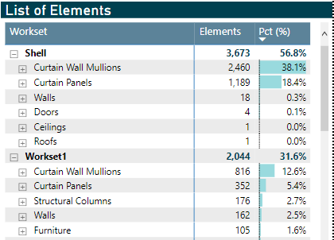
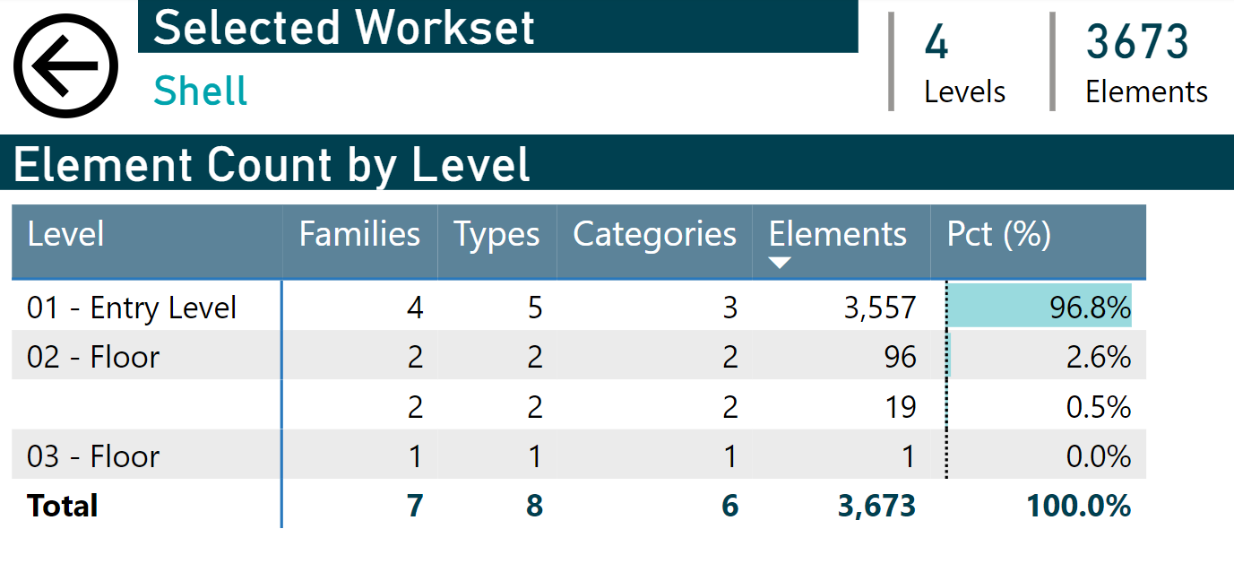
Example Customization #2
Add a drill through page
Query: What is the distribution of elements by Level for a selected Workset?
Solution: Create drill-through page with specific view user expecting
Dynamically see detailed breakdown of a selected Workset like this
Right click a Workset, then select ‘Drill Through’
From ‘Element Summary’ page
'Hidden’ Drill Through page (‘DT-Example’)
Notes:
Lazy Method: Just select it on the template page!

Slide 52
Develop your ROADMAP
x5
POWER QUERY EDITOR
REPORT EDITOR
Notes:
Who?
Mins?

Slide 53
Advantages and limitations
Consider the opportunity costs of your deployment
Advantages
Limitations
General Points
Scripts are self-service, on demand Small footprint (JSON files)
Engaging interactive reports, rapid turn-around
Ability to add company-specific user guidance
Minimal focus on data processing
re
Cannot fully automate execution of Dynamo yet
Single model snapshot only; no comparison features
Power BI Desktop (Free Only)
Automatic, consistent, repeatable transformations
Source data unmodified by process
Allow users to export filtered data as needed
Incremental development
No publishing, collaboration features
Does not leverage best features of Sharepoint
Sub-optimal workflow for end users, who must refresh data each time (takes time to re-calculate)
Power BI Pro (or higher)
Web-based platform, centralized sharing
Dataflows + scheduled refreshes
Collaboration: Publishing, Teams integration
Row-based security, incremental refresh
Complex merges cannot be done without Premium level (but there are workarounds!)
JSON files are not centrally managed (no tracking)
ADVANCED TOPICS
Notes:
Are there options other than Power BI
There are other solutions aside from Power BI, but Power BI is perhaps among the most successful
Some web platforms are also great, but not if your company is big (1000+)
Tableau is very powerful, but also way more expensive to start
What are Advantages of power BI
In essence, you can always ADD more on top, which is better for incremental improvements (unlike others)
Power BI has a ton of incremental features depending on which version
Desktop is free and contains almost all technical functions
Pro doesn’t add more report editing capabilities, just more collab / workflow efficiency features
Premium adds ever more efficiency features

Slide 54
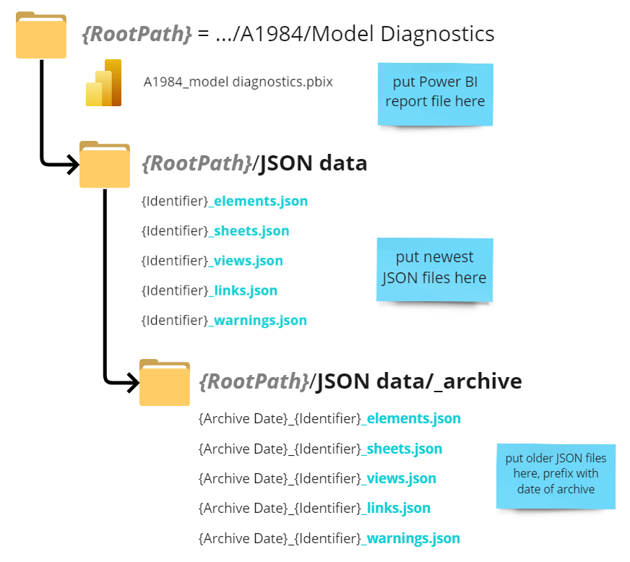
Structure your files and folders
How to repeat this analysis consistently, improve workflow automation
Why do this?
Stronger naming / structure conventions enables tools like Power BI to locate and distinguish JSON files intelligently
Develop folder structure and naming system
Allows Power BI to programmatically find JSON files by version, project, model based on path and file name
Date stamp older data (YYYYMMDD)
Separate data from dashboards
Make most current file name consistent
Allows for future expansion
{identifier} should uniquely identify model and project corresponding to JSON file
Notes:
Develop folder structure and naming system
Use Power Automate to automate file transfer
Leverage Automation + Collaboration features of Power BI Pro
Folder structure makes promotes search reliability
Does not eliminate human error, but certainly can improve consistency

Slide 55

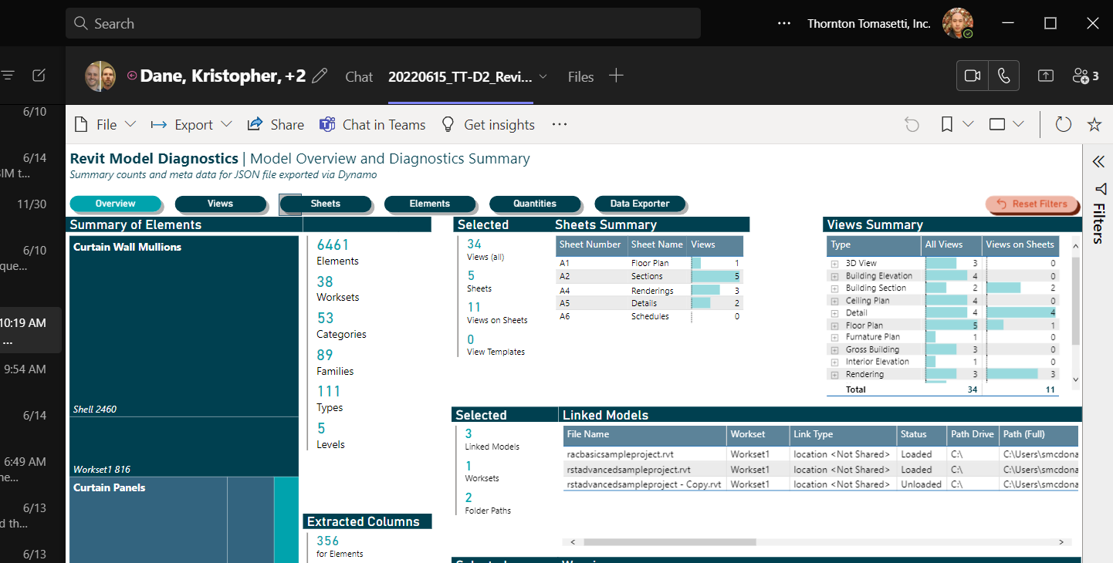
Publish and Share
This template is a good example of where the cost of Power BI Pro is justifiable!
How to repeat this analysis consistently, improve workflow automation
Why do this?
Publishing and refresh automation are among the most useful features of Pro in terms of workflow efficiency and optimizing the end user experience
Publish your Dashboard to a workspace
Provide users access to workspace
Provide users persistent link to report (or just have users log in to web platform)
Pin Power BI report to Microsoft teams
Use dataflows, schedule refreshes
Pre-calculates data for dashboards to reduce load time for end users (more efficient)
Notes:
Overall, the goal here is to reduce the time between data acquisition and data interpretation.
This means avoiding the following as much as possible
Time xferring and renaming files, managing files
Repeating the same calculations each time new data arrives
Finding where a file is stored or logging into a web portal to find a report
Copying data from a static PDF report back to Excel
Forcing end user machines to perform calculations that all users would benefit from

Slide 56
Leverage Power Automate
ADVANCED TOPIC
How to repeat this analysis consistently, improve workflow automation
Why do this?
Save time and reduce clerical reduce errors by automating data transfer and file renaming tasks
Create an ‘Incoming’ Folder
Establish a new connection to your folder in Power Automate + validate credentials
Create flow logic (not covered in this slide deck):
Trigger if new file added to Incoming folder
Check if files exist in destination folder
If files exist
prefix file name with current date in ISO format (YYYYMMDD)
Move renamed files to _archive folder
Otherwise
Move new files from Incoming to destination folder
4. Test flow by dropping off JSON files in Incoming Folder
Use Power Automate for File Management
Comes with Office 365 if you have it
Now allows connections to offline source (with proper credentials)
Move and rename files based on logic
Could also be done with Task Scheduler and PowerShell if you have the skills!
Can be combined with Microsoft Forms to further automatic intake process
Notes:
Use Power Automate to automate file transfer
Leverage Automation + Collaboration features of Power BI Pro

Slide 57
FURTHER DEVELOPMENT
ADVANCED TOPIC
What features would be universally beneficial to all users?
Allow report to handle multiple snapshots, models
You need more data columns that distinguish which model, which snapshot, and which project
See folder structure recommendations
Key Performance Indices (KPI) – can we summarize a model’s quality with a single number?
Define thresholds that should cause concern to modeler or BIM manager (e.g. too many line styles? Too many views not on sheets?)
Metric allows you to track model health over time and across projects/models on demand

Slide 58
Your homework
Notes:
Who?
Mins?

Slide 59


Your homework
Getting started on your own
Download file from GitHub Repo (see QR code)
Power BI Template
Dynamo Scripts
Additional Resources for Devs
Do the Preparation Checklist
Run Dynamo on a model
Save JSON files in a folder
Configure Template
Update parameters to JSON files + path
Refresh Data!
Optional Next Steps
Customize Template
Develop Roadmap
GitHub Repo

Slide 60
What’s in the GitHub Repo?
Table of Contents
Power BI reports (where Power BI template is stored)
Power BI Data
Where you should put your JSON files
Includes a sample set to help you start
Sample Models (Revit model used in demo)
Dynamo Scripts (Dynamo scripts to be run on Revit models)
Resources
Handouts / Notes
This slide deck

Slide 61
Thank you
Contact info
ThorntonTomasetti.com

Slide 62
Workshop Summary
What is this?
Leverage Dynamo and Power BI to produce on-demand, interactive diagnostic reports on the quality of your BIM models.
Learning Objectives
Create / Execute Dynamo Script on a Revit model
Transform model data using a Power BI template
Customize dashboard to support your needs
Identify potential for workflow automation + scaling
Notes:
Why are We Doing This?
Desire to give BIM managers and modelers have greater visibility of model quality
Time consuming to manually evaluate BIM model quality; Dynamo and Power BI can automate this process quickly + consistently
Self-service; does not depend on some centralized process

Slide 63

JSON Data Contents
ADVANCED TOPIC
How/why split big tables into smaller ones?
May need to apply 2 sets of filters to get different results simultaneously
Master table allows for centralized slicing of two related tables
Separate data by formatting (quantitative vs qualitative)
Easiest way to invite users to create custom tables
Notes:
Each JSON file is used to create 1 or more tables
What did I do to clean the data? The entire transformation history is saved in the template!
You can try to modify the transformations but make sure you save the report state before you do

Slide 64



Data loading issues
ADVANCED TOPIC
Issue
Elements_geometry, Elements_explore, or summarize_geometry tables are loading data incorrectly
Explanation
Template tries to generalize steps, but your model contains attributes not included in template (particularly quantitative values)
To fix Elements_geometry…
In the step, 'Removed Columns', make sure that the column you are looking for was not removed
If the column has both units and value in the cell, you will need to split this column by a delimiter (usually a space), then rename the columns…
Notes:
Lazy Method: Just select it on the template page!

Slide 65


Data loading issues (cont.)
ADVANCED TOPIC
Issue
Elements_geometry, Elements_explore, or summarize_geometry tables are loading data incorrectly
To fix Summarize_geometry
Insert step after the 'Filtered Rows' step to remove any rows that you do not want to appear in the summary list
Add a new 'Unpivot Columns' step and unpivot only the columns you want to be summarized, then delete the old 'Unpivot Columns' step
Split the columns as needed to separate units from the value (cannot do math otherwise) + remove any remaining unwanted columns or rows
Notes:
Lazy Method: Just select it on the template page!

Slide 66

Data loading issues (cont.)
ADVANCED TOPIC
Issue
Power BI is looking for a column that does not exist in the JSON files
Explanation
Power BI is trying to generalize steps from the template to your specific data, but certain columns are missing from the JSON file
How to Fix?
(Recommended) add a new column to the JSON file; this will allow Power BI to continue, but the column values will be all empty
Better than trying to find every instance of it in Power BI…
Notes:
Lazy Method: Just select it on the template page!

Slide 67


Data loading issues (cont.)
ADVANCED TOPIC
Issue
Dyanmo files updated to add new data, but Power BI doesn't recognize new columns in Element-related tables
Explanation
Template does not include the new columns, so it will simply skip importing them.
How to fix:
Edit all table queries prefixed with Elements_ in PQ Editor. In the Advanced Editor within PQE:
…
In Advanced Editor within the 'Expanded Column' step, add the new column name at the end of the comma-separated list
(add column name at the end, e.g.
… “z Offset Value”, “NewColumnName”}
Add/remove rows or columns as necessary
Notes:
Lazy Method: Just select it on the template page!

Slide 68

Example Customization #3
ADVANCED TOPIC
Add a new measures and calculated columns
Query: How many views appear in sheets?
Solution: 3 different ways of getting this, but different use cases!
Option 1: ‘Lazy* Solution’
1. Use Views_master table
2. Count distinct sheet numbers and view names
3. Use filter to remove “---” from results. Done!
Why is this ‘lazy’?
For this calc to work, we manually set the filter to remove “---”
What if the user wants to see all the views but also see the number of Views on Sheets? Too bad.
What if we just want a single button to quickly filter to views on a sheet (all of them)? Also, too bad.

Slide 69
Example Customization #3
ADVANCED TOPIC
Add a new measures and calculated columns
Query: How many views appear in sheets?
Solution: 3 different ways of getting this, but different use cases!
IsViewOnSheet = IF( Views_master[Sheet Number] <> "---", "Yes", "No“ )
Option 2: Column Calc + Measure
Create a calculated column in View_master that indicates Yes/No if a view is on a sheet
Create a measure in View_master that counts rows where [Category] = “Views” and [Sheet Number] is NOT “---”
num_views_on_sheets = CALCULATE(
COUNTROWS(Views_master),
FILTER(ALL(Views_master),
Views_master[Category] = "Views" &&
Views_master[Sheet Number] <> "---"
)
)
Do we need both?
Yes, if you want to calculate the total views on sheets REGARDLESS of what filters are selected.
For example, if you filter out Sheet A2, you may want to know the SELECTED number of sheets on views versus the TOTAL number of sheets on views.

Slide 70

Example Customization #3
ADVANCED TOPIC
YES/NO Column allows us to select ALL views on sheets (rather than individually)
Add a new measures and calculated columns
Query: How many views appear in sheets?
Solution: 3 different ways of getting this, but different use cases!
Option 2: Column Calc + Measure
Create a calculated column in View_master that indicates Yes/No if a view is on a sheet
Create a measure in View_master that counts rows where [Category] = “Views” and [Sheet Number] is NOT “---”
Are there other ways?
Yep! Can create a calculated column in Sheets_master to find the total number of views per sheet (rather than Views_master) table, then add these numbers.
Advantageous b/c it gives you the views PER sheet as a filterable column, rather than a dynamic calculation (which cannot be used as a slicer).
When A2 is filtered out, only 6/11 views on sheets remain

Slide 71
outline
Introduction (Kris) (10 min)
Digital Design at Thornton Tomasetti
Problem
Solution Outline
Live Demo (Kris / James) (10 min)
Deep Dive into Tool Components (40 min)
Dynamo – Sean (20 min)
Power BI – James (20 min)
Q/A (James and Sean) (15 mins)

Slide 72
introduction
Digital Design (D2) at Thornton Tomasetti
Develop and drive BIM standards and workflows
Interface between corporate staff (departments) and staff working on projects (practices)
Support IT department to streamline technology infrastructure for client work
Develop workflows and policies for standardizing practices
Evaluate and deploy vendor technologies, software, and services
Improve corporate and staff ability to ‘drive with data’
Notes:
Also introduce speakers here

Slide 73
D2 Mission
Sinek’s Golden Circle
What? We maintain and implement the tools for collaboration (BIM / Autodesk / etc…). We liaise with other organizations to help connect the needs with solutions.
How? Through development of internal processes, enabling ease of communication of standards, training, and creating tools that drive efficiency.
Why? So project teams can do work that is worth their time; to focus on high value, high impact problems rather than the commodity activities.
“You do not rise to the level of your goals. You fall to the level of your systems” – James Clear

Slide 74
Problem – NEED DATA, HATE GETTING IT
Digital Design at Thornton Tomasetti
How can we answer all these questions automatically for every model, every time?
Key questions for models?
How many sheets do I have, and how many views are on sheets?
Are objects in the correct worksets?
How much and what kind of stuff so I have in my model?
What are the design quantities of the model elements?
How can I export model data to Excel for further analysis?
Are the right kinds of things in the right views? According to standards)
What’s the Problem?
Checking models is resource intensive!
Time-consuming, tedious, and inconsistent when performed manually
Not easy to query / search elements in model using Revit UI… and tons of elements!
Checks yield info valuable in diagnosing potential model issues / measuring model health
Need ability to diagnose model health quickly, consistently, on demand
Notes:
Precisely a problem D2 should work on, as automation can really help:
Minimize data processing time and maximize user time for data consumption/interpretation
This is a classic problem of valuable data existing somewhere
The process of extraction isn’t inherently difficult
but is not valuable b/c resource intensive

Slide 75
Problem – NEED DATA, HATE GETTING IT
Digital Design at Thornton Tomasetti
Key questions for models?
How many sheets do I have, and how many views are on sheets?
Are objects in the correct worksets?
How much and what kind of stuff so I have in my model?
What are the design quantities of the model elements?
How can I export model data to Excel for further analysis?
Are the right kinds of things in the right views? According to standards)
What’s the Problem?
Checking models is resource intensive!
Time-consuming, tedious, and inconsistent when performed manually
Not easy to query / search elements in model using Revit UI… and tons of elements!
Checks yield info valuable in diagnosing potential model issues / measuring model health
Need ability to diagnose model health quickly, consistently, on demand
Notes:
Precisely a problem D2 should work on, as automation can really help:
Minimize data processing time and maximize user time for data consumption/interpretation
This is a classic problem of valuable data existing somewhere
The process of extraction isn’t inherently difficult
but is not valuable b/c resource intensive

